Slide 1
Toast Notifications
Sulaxan Jadhav

Slide 2
Agenda
Introduction to Toast Notifications

Slide 3
1. What Are Toast Notifications?
A Toast is a small message that appears at the bottom (or a custom position) of the screen and automatically fades out after a short period.
Toast notifications are designed to provide simple, unobtrusive feedback to the user.
They do not block the user interface and do not require any user interaction.
Duration: Toasts are generally displayed for a short or long duration, and then they disappear automatically. Developers can specify the length of time (e.g., Toast.LENGTH_SHORT or Toast.LENGTH_LONG).
Content: A Toast can display simple text messages or custom layouts.
Position: The default position is at the bottom of the screen, but it can be customized to appear elsewhere.

Slide 4
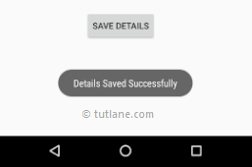
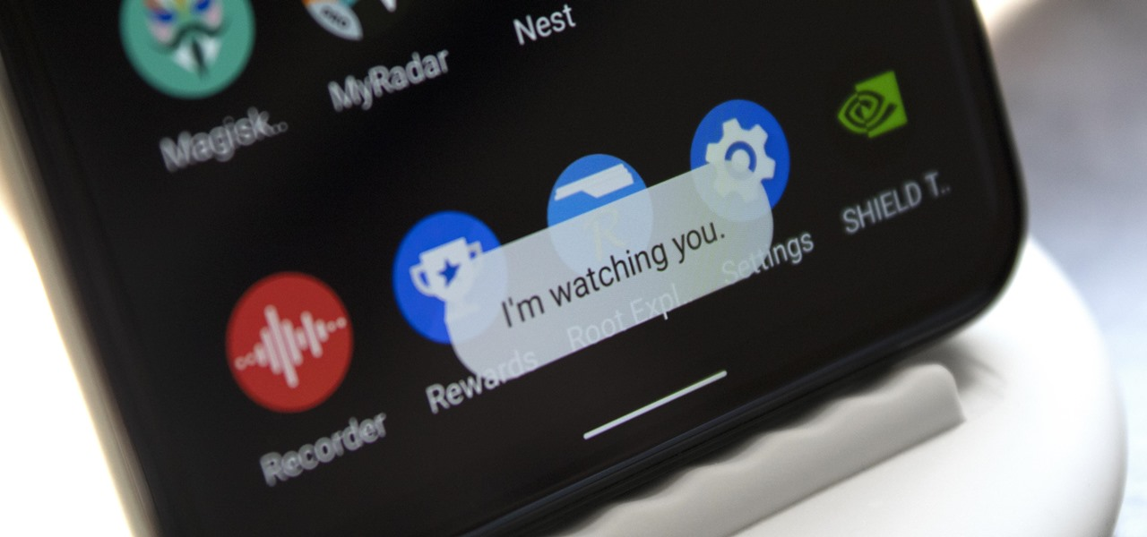
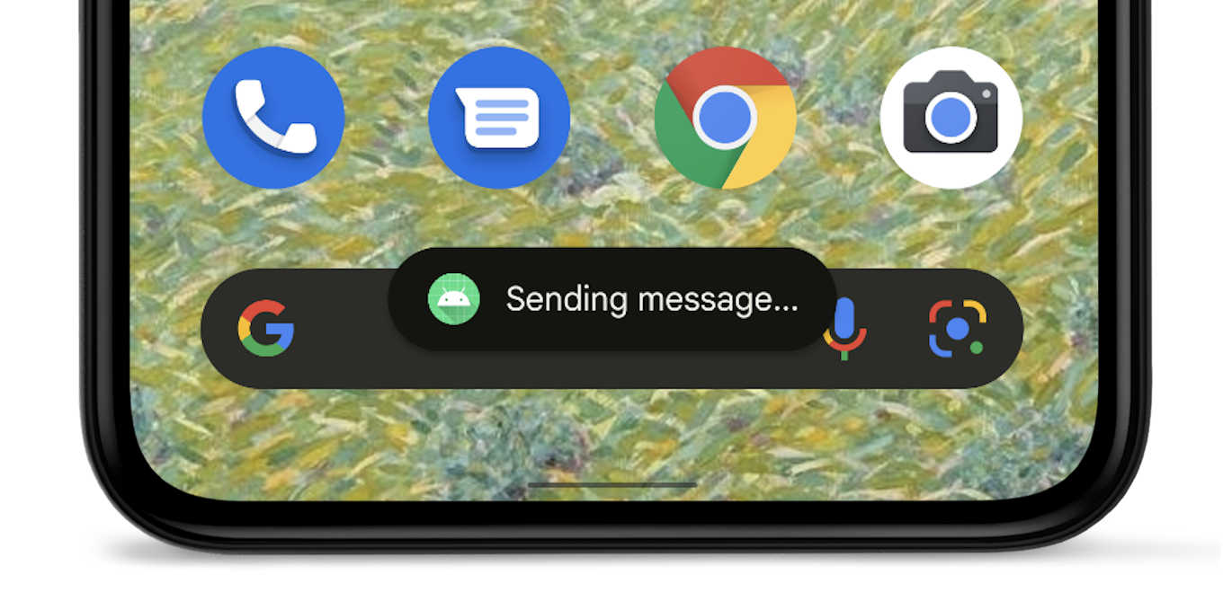
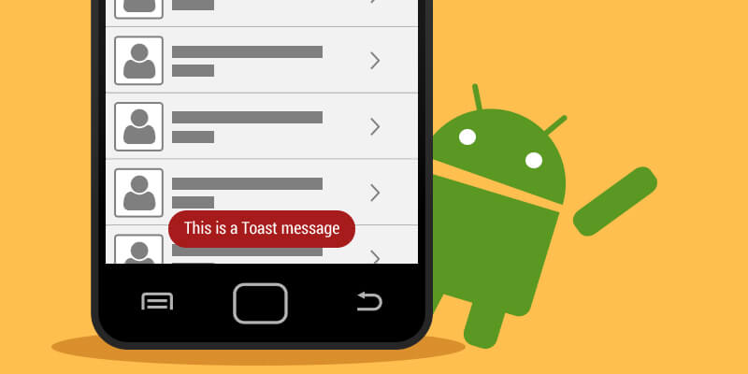

Slide 5
Toast.makeText(getApplicationContext(), "This is a Toast message", Toast.LENGTH_SHORT).show();

Slide 6
2. When and Why to Use Toast Notifications?
Confirmation Messages: Display a quick message to confirm an action (e.g., "Message Sent" after sending a message).
Informational Messages: Provide feedback or information without interrupting the user experience (e.g., "Settings Saved").
Error Messages: Show simple error messages that don’t require user action (e.g., "Network Error, Please Try Again").
Background Task Updates: Inform the user about the progress or completion of background tasks (e.g., "File Uploaded Successfully").
No User Interaction Required: When the notification does not require any user response or action.

Slide 7
Advantages of Using Toast Notifications:
Non-Intrusive: Toasts appear on the screen without interrupting the current activity.
Lightweight: They are easy to implement and do not require much system overhead.
Quick Feedback: Ideal for providing quick feedback to users about their actions or system events.
Customizable: Developers can customize the appearance, duration, and position of Toast notifications.

Slide 8
Limitations of Toast Notifications:
No User Interaction: Toasts do not allow for user interaction, such as clicking or tapping to dismiss or take action.
Transient Nature: They disappear after a short duration and cannot be recalled by the user if missed.
Not Suitable for Critical Information: Toasts are not ideal for delivering important or persistent messages since they may go unnoticed.

Slide 9
Snackbar:
A Snackbar is similar to a Toast but is slightly more powerful and flexible.
It appears at the bottom of the screen and can provide an action button (e.g., "UNDO" action after deleting an item).
Unlike Toasts, Snacks can be swiped away by the user, and they are more suitable for displaying messages that require user action.
Use Cases: Error messages with undo actions, notifications with simple options.

Slide 10
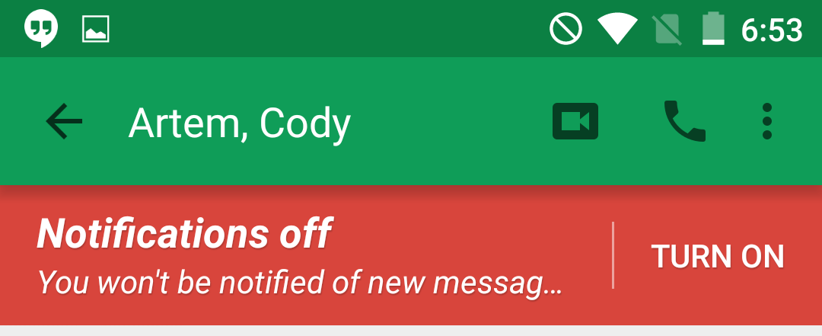

Slide 11
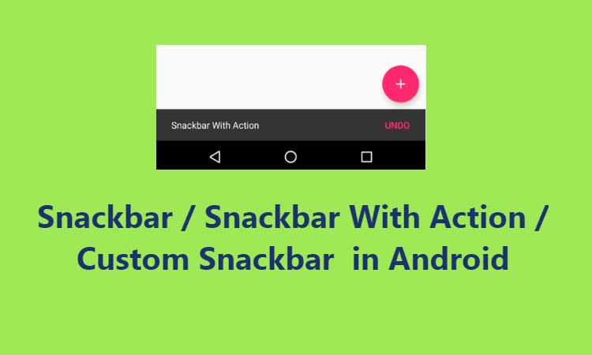

Slide 12
Dialog:
A Dialog is a more interactive type of notification that blocks the UI and requires user action to continue.
It can contain various UI components, such as buttons, text fields, lists, and custom layouts.
Types of Dialogs: AlertDialog, ProgressDialog, DatePickerDialog, etc.
Use Cases: Important alerts, confirmation dialogs, input forms, critical user decisions.

Slide 13
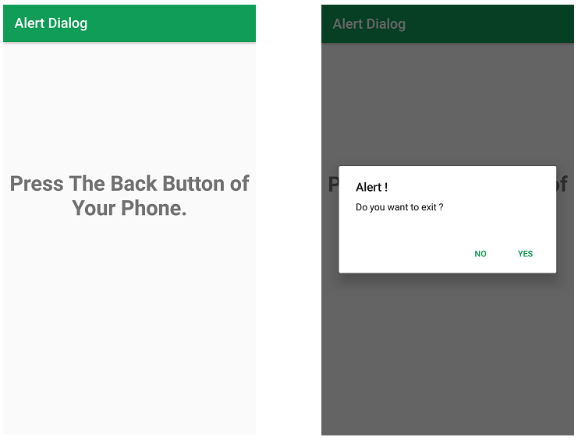

Slide 14
Creating Basic Toasts in Android
Toasts are a simple and effective way to provide feedback to users in Android applications.
In this section, we will go through the process of creating basic Toast notifications using the Toast.makeText() method, explore how to control their duration, and provide a practical example of displaying a Toast on a button click.

Slide 15
Toast.makeText() Method
The Toast.makeText() method is the primary method used to create and display Toast messages in Android.
It has a simple syntax and is easy to implement in any Android application.
Syntax
Toast.makeText(Context context, CharSequence text, int duration).show();
Parameters:
Context: The context in which the Toast should appear. This is usually the activity or application context.
CharSequence text: The text that will be displayed in the Toast. This can be a string or any text-like object.
int duration: The duration for which the Toast will be displayed. The duration can be either Toast.LENGTH_SHORT or Toast.LENGTH_LONG.
.show() Method: This method is called to display the Toast on the screen.

